Slide 1
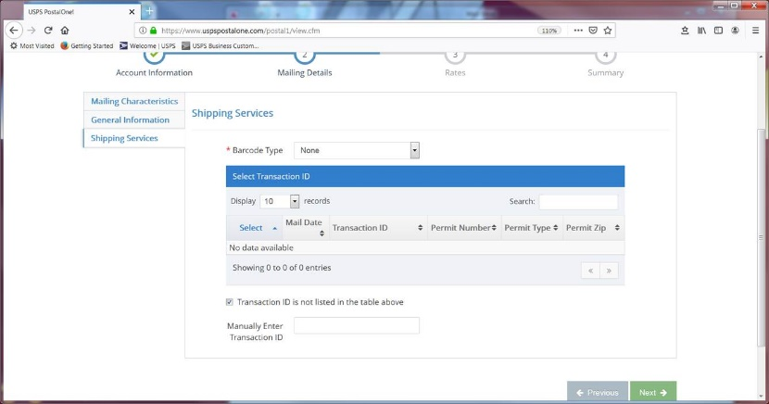
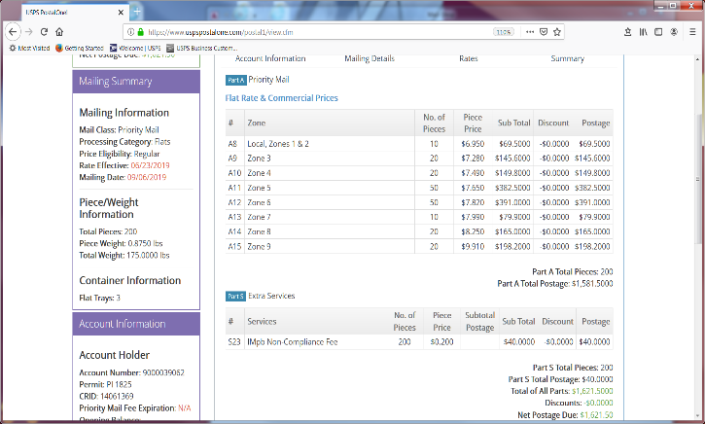
TASK:
Redesign workflow for AST REORG LTS to include postal sorting.
PURPOSE:
Reduce Postage costs by:
- Sending Presort First Class or Presort Priority when applicable.
- Adding Intelligence Mailing Barcode for Priority Mail to avoid “IMB Non Compliance Fee”
Reduce time and increase accuracy for mailings sorted by zone.
v

Slide 2
CONSTRAINTS TO CONSIDER
ENVELOPE WINDOW SIZE
ADDRESS UP TO 8 LINES
LT BARCODE MUST REMAIN N THE WINDOW; USED BY MAILROOM FOR PACKAGES RETURNED BY POST OFFICE
TIME
HAND VS. MACHINE INSERTING
DOCUMENT FORMAT AND ADDRESS PLACEMENT
SOME RIGIDITY IN CONTROL OF DOCUMENT FOR BOOKLET LTS
BOOKLETS TYPESET AND APPROVED BY AST CLIENT; MODIFICATIONS WILL REQUIRE ADDITIONAL REVIEW BY RM
DOCUMENTS PRINTED BY OUTSIDE VENDOR CANNOT BE CHANGED
POSTAL REGULATIONS FOR QUALIFICATION
WINDOW MUST BE IN THE UPPER SECTION OF THE ENVELOPE FOR FLATS PIECES.

Slide 3
PROPOSED WORKFLOW
CSR can facilitates postal decisions prior to Production Floor processing.
1) maintain mock booklets of various page sizes, paper and BRE to simulate a mail package; or
2) Print mock of inserts on printer for each mailing. Programmer provides CSR with weight and measurements of the piece.
Full package must be obtained for packages with inserts printed by outside vendors.
RM sends job via email
Mike Aronne checks record counts
CSR and Programmer review job and mail piece
Mail Piece over 13 oz ?
NO POSTAL CONSIDERATIONS
YES
NO
Total weight of mailing 50 lbs. and up?
Domestic Records over 500 ?
For Labels ?
Foreign Exchange Form ?
For Admark ?
For Email ?
NO
YES
YES
NO
Presort First Class
Straight First Class
Mike Aronne places data in file drop
Flat Rate
Priority Mail
DS sends samples to RM for review
No Sorting needed
Mike Aronne places data in file drop and emails counts
Mike sends samples to RM for review
Mike Aronne sends samples to RM for review
DS creates files after RM approval
DS presorts
After RM approval, Mike Aronne places print files in file drop and emails counts
PDFs are placed in file drop for RM to retrieve.
After RM approval, Mike Aronne places print files in file drop and emails counts
DS sends samples to RM for review
DS creates print files after RM approval
Print files are placed on Production floor.

Slide 4
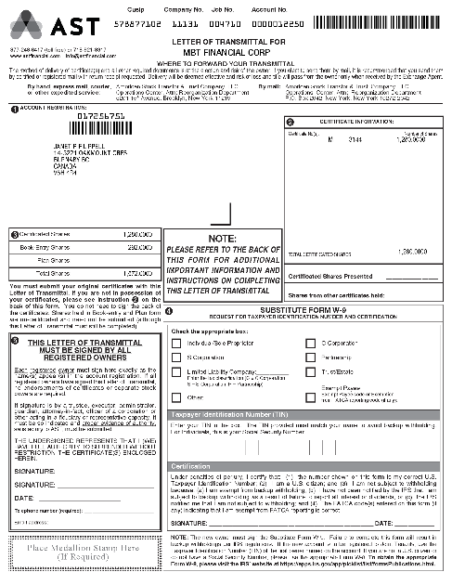
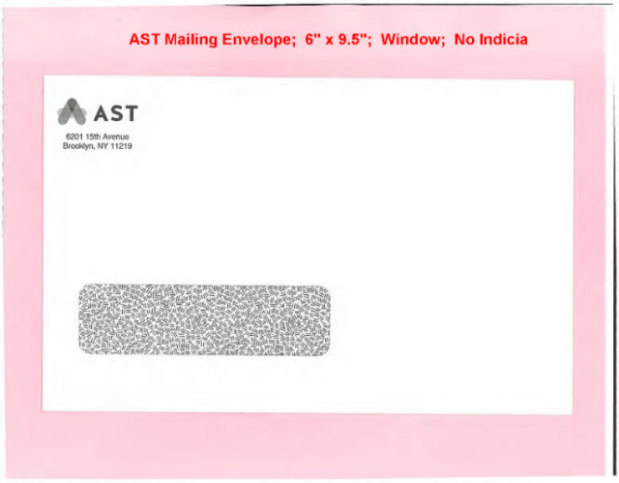
GENERIC LTS
OE
-6 x 9.5 Envelope
SOME COMMON INSERTS
-W-9 Guidelines
-Shareholder Letter
-FX Form
-BRE
TRANSITION CONCERN(S)
-Address with IMB and LT Barcode too large for envelope
RECOMMENDATION(S)
Create Larger window for 6 x 9.5 Env
-No change to LT design
-Machinable
-Retains Letter postage price
-Adds additional envelope to inventory
Create 6 x 9.75 Env with new PMC Window. Add Leader sheet with address on the right side.
-No change to LT design
-Machinable
-Retains Letter postage price
-Extra sheet adds to weight, paper and impression count
-Adds additional envelope to inventory
NOTE: Use Center Pocket 9 x 12 Env for inserts too large for 6 x 9.5

Slide 5
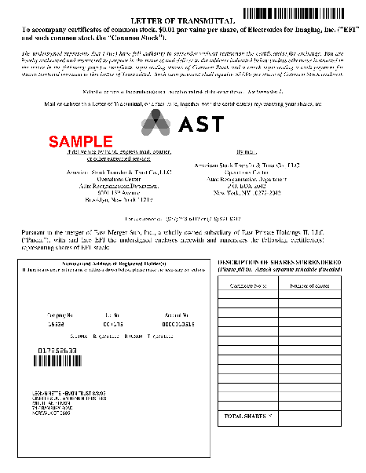

BOOKLET LTS
OE
-9.5 x 12 Lower Left Window Env
SOME COMMON INSERTS
-W-9 or W-9 Guidelines
-Shareholder Letter
-Notice of Guaranteed Delivery Bklt
-Offer to Purchase Bklt
-FX Form
-BRE
TRANSITION CONCERN(S)
-Address must be in center IAW Postal Regulations
-Document variability and format increases process variability
RECOMMENDATION(S)
*Extra Page on Booklet with Address in front
-No change to LT design
-Machinable
-Adds extra weight and postage

Slide 6
OTHER PRODUCTION CONSIDERATIONS/ALTERNATIVES
Keep supply of blank stock of new PMC 6 x 9 ¾ envelopes and admark as needed
- Limits inventory of different types of envelopes
- May be costlier
- Work load on admark machine increases
Convert other 6 x 9.5 envelope jobs to the PMC envelope
- Limits inventory of different types of envelopes
- Some modification of templates required
- Jobs may require a leader sheet, adding postage, paper and impressions
Jobs that use 6 x 9.5:
Due Diligence Reorg
DRS Dematerialization Letter
Aged Lost Securities Letters
Vodafone Proxy (> 100,000 cards each year)
Microfocus Proxy (~ 50, 000 cards each year)
Jobs that use 6 x 9.75:
PMC
OLP
SOI

